Slide 1

Blood relation
Placement Preparation
Aptitude & Reasoning
Prof. Krunal D. Vyas
Computer Engineering Department
krunal.vyas@darshan.ac.in
9601901005

Slide 2
Introduction
Symbols used for Relation representation
X_{M} = indicates X is male
X_{F} = indicates X is female
X Y = Husband wife
X – Y = Sibling
X = Son or Daughter
Y

Slide 3
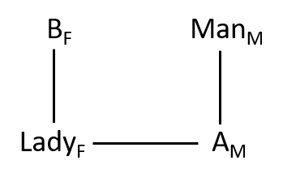
Type-1: Indicating form
Example: Introducing a man, a lady said that “He is the father of my mother’s daughter’s only brother”. How is the man related to lady?
Solution:
The man is father of that lady.

Slide 4
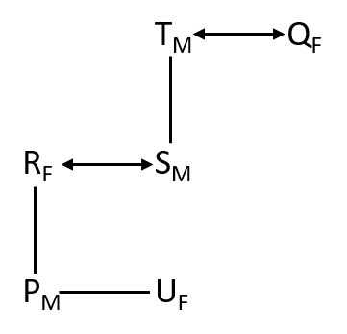
Type-2: Puzzle form
Example: P, Q, R, S, T and U are six members of a family. There are two married couples among them and total members of female in the family is three.
• R is the mother of P and U
• T is the father of S
• P is the grandson of T
Q-1 How Q is related to U?
Q-2 Who is daughter of S?
Q-3 If X is married to U then how X is related to S?
Solution:
Answer - 1: Grandmother
Answer - 2: U
Answer - 3: Son-in-law

Slide 5
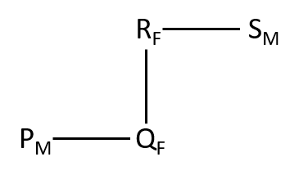
Type-3: Coding form
Example: ‘A+B’ means ‘A is the father of B’
‘A-B’ means ‘A is wife of B’
‘AxB’ means ‘A is the brother of B’
‘A/B’ means ‘A is the daughter of B’
In which of the following means ‘S is father of P’
(1) P/Q-RxS (2) PxQ/R-S (3) P-QxR/S (4) P/Q+RxS
Solution:
PxQ/R-S is the correct answer.

Slide 6
Exercise
Ex-1: Pointing to a girl in the photograph, Raju said, “Her mother’s brother is the only son of my mother’s father.” How is the girl’s mother related to Raju?
Ex-2: In a family, there are six members A, B, C, D, E and F. A and B are a married couple, A being the male member. D is the only son of C, who is the brother of A. E is the sister of D. B is the daughter-in-law of F, whose husband has died. How is E related to C?
Ex-3: If 'A $ B' means 'A is brother of B', 'A @ B’ means 'A is wife of B', 'A # B' means 'A is daughter of B' and 'A & B’ means 'A is father of B', then which of the following expressions indicates the relationship 'K' is father-in-law of H’?
A) H @ J $ L # P & K
B) H @ J $ P & L # K
C) H @ J $ L # K & P
D) H @ P $ J & L # K
Ans = Aunt
Ans = Daughter
Ans = C) H @ J $ L # K & P

